Slide 1

E-COMMERCE WEBSITE

Slide 2
CONTENT
INTRODUCTION
PROCESS OF FOOD DELIVERY
FEATURES OF PROJECT
PROJECT DISCRIPTION
DATA FLOW DIAGRAM
LANGUAGE AND TOOLS USED
ADVANTAGES OF FOOD DELIVERY SERVICES
FUTURE PLANS
OUTPUT SCREENS WEBSITE
CONCLUSION

Slide 3
INTRODUCTION
The Online Food Ordering System can be defined as a simple and convenient way for customers to purchase food online , without having to go to the restaurant .This system is enabled by the internet – it is the internet that connects the restaurant or the food company on one hand, and the customer on other hand.

Slide 4
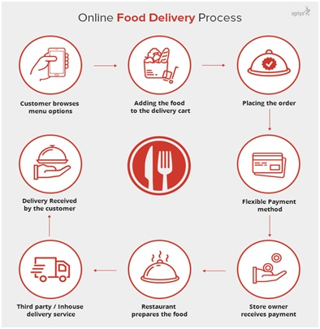
PROCESS OF E-COMMERCE

Slide 5
FEATURES OF PROJECT
Home
Restaurant Browsing
List
Dishes Browsing
Search
List
Registration and Login
Cart
Order Summary
Checkout
Delivery Status

Slide 6
PROJECT DISCRIPTION
The Front-End of our Food Delivery Website is completely designed using the two most powerful and widely used language, namely:
1. HTML5
2. CSS3
The website contains various pages like About Us, Contact Us, Login, Signup, Dish Pages.
Each and every page of this Food Delivery site is semantically structured completely using the HTML5.
And the styling and designing of pages was done, solely, with the help of CSS3.

Slide 7
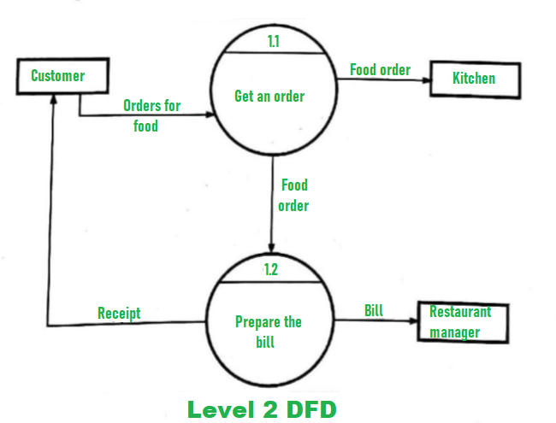
DATA FLOW DIAGRAM

Slide 8
LAGUAGE AND TOOLS USED
LANGUAGE
TOOLS
HTML
CSS 3
Bootstrap
PHP
MySQL
XAMPP Server

Slide 9
ADVANTAGES OF E-COMMERCE
Faster buying procedure, as well as easy to find dishes.
User friendly navigations to provide ease.
More reach to customers, there is no theoretical geographic limitations.
No need of physical company set-ups.
Easy to start and manage a business.
It’s fast, easy and comfortable
Less hassle

Slide 10
FUTURE PLANS
We are thinking of some modifications and adding some advanced new
features in our system. Some of them are :
GUI modification (more user friendly)
Recommendation on the basis of previous orders
Users can signup / login using their social media account such as
facebook , google+ etc.

Slide 11
OUTPUT SCREEN OF
WEBSITE

Slide 12
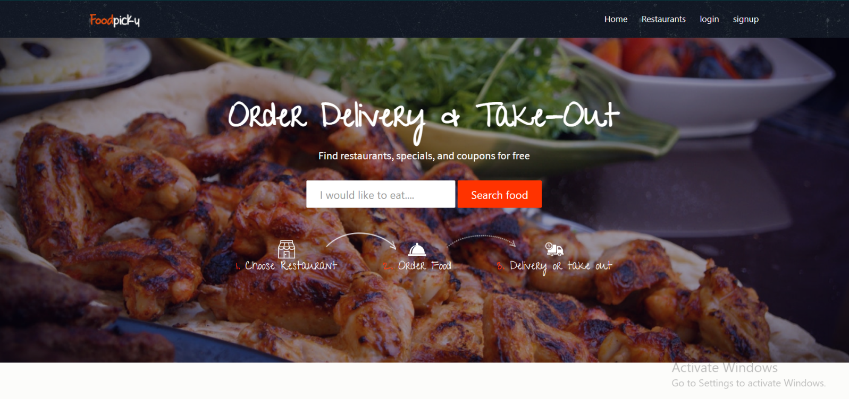
HOMEPAGE

Slide 13
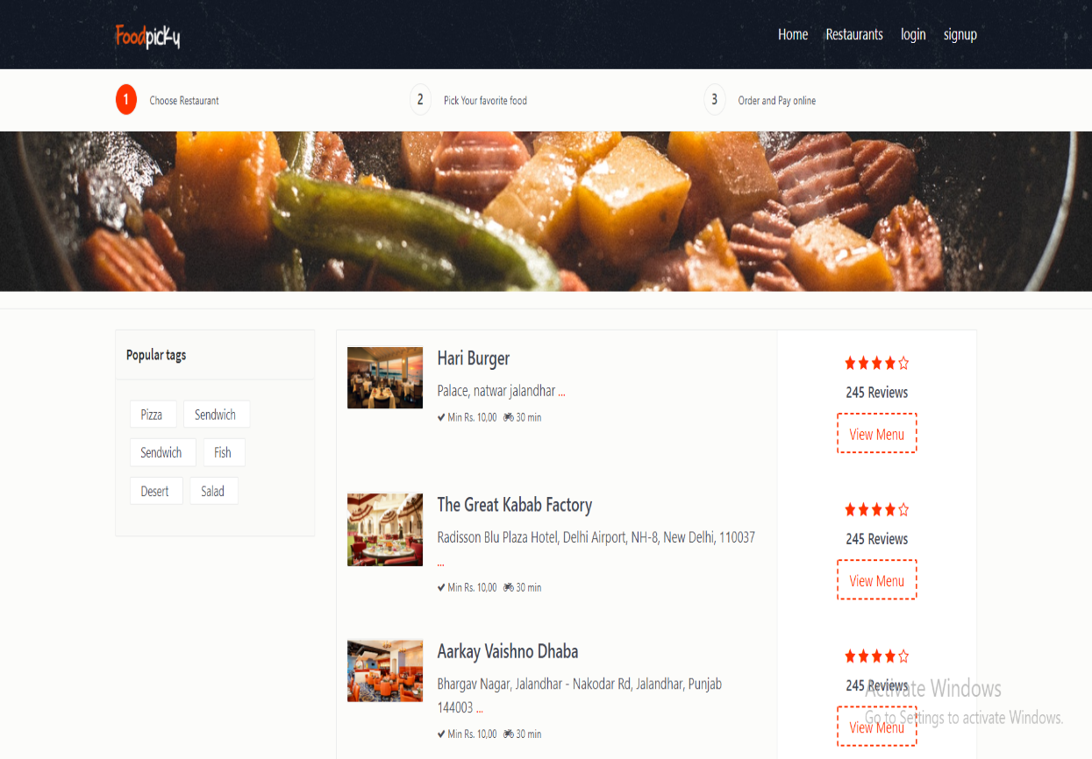
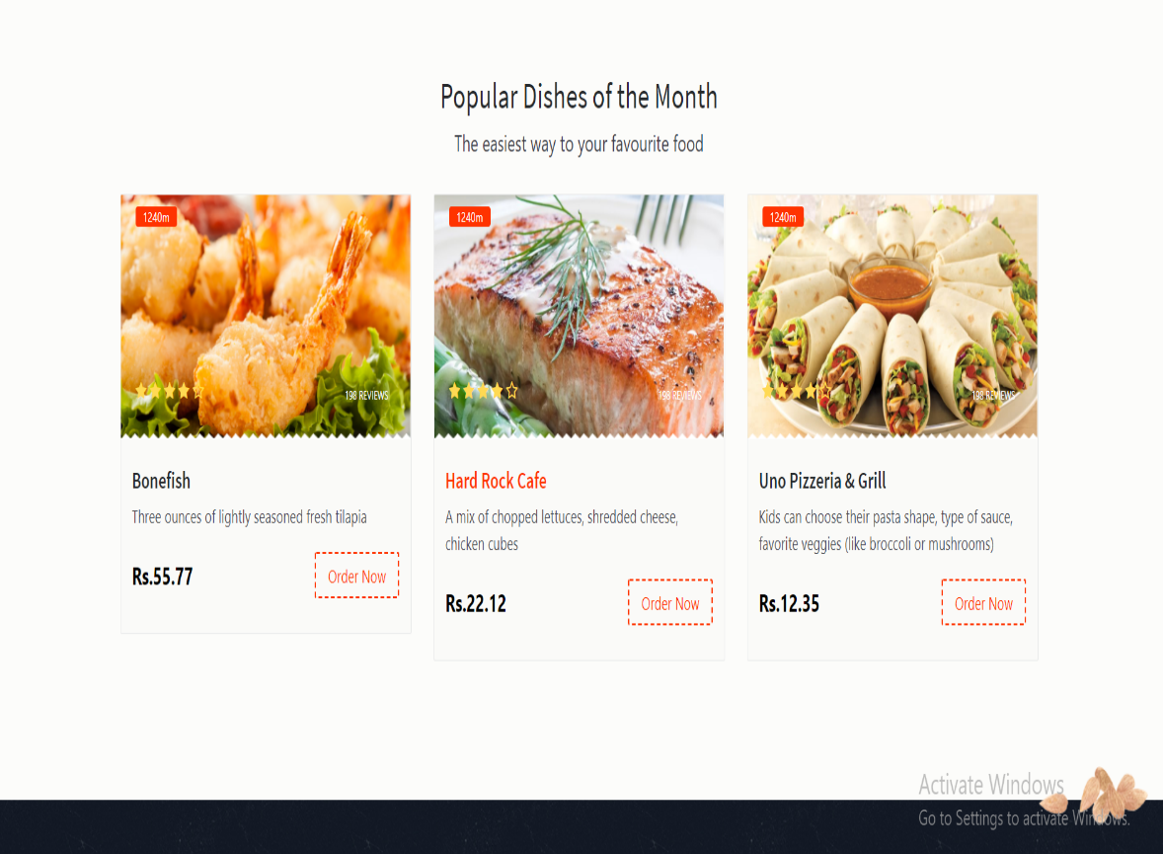
STORE

Slide 14
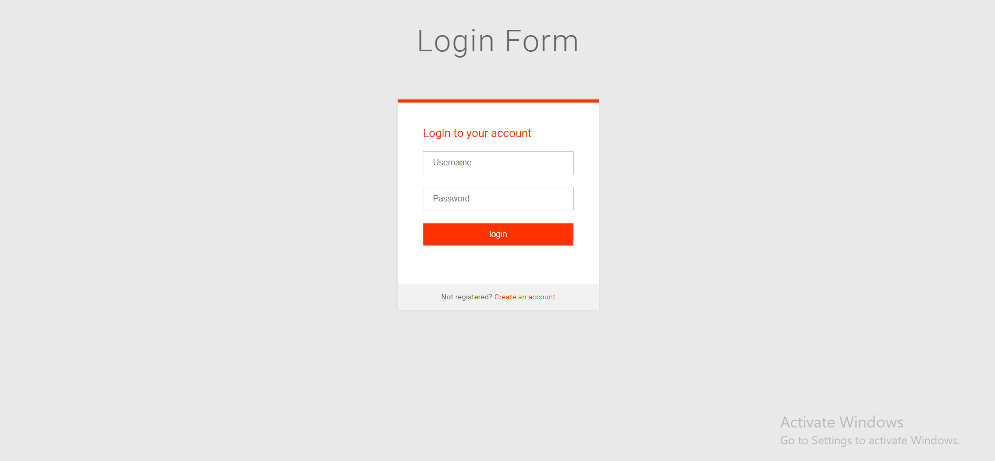
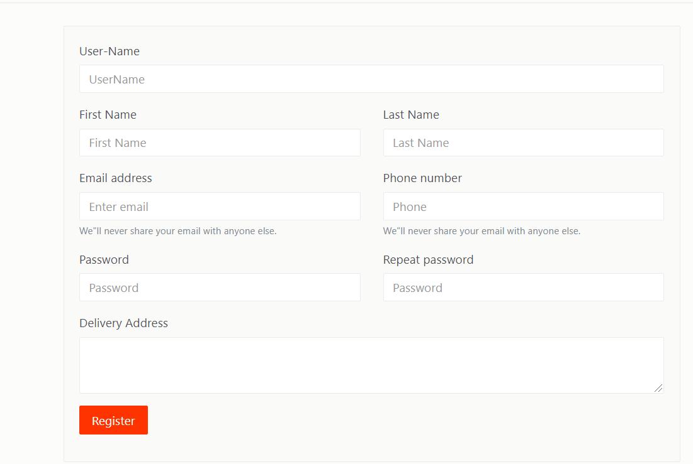
LOGIN AND SIGNUP

Slide 15
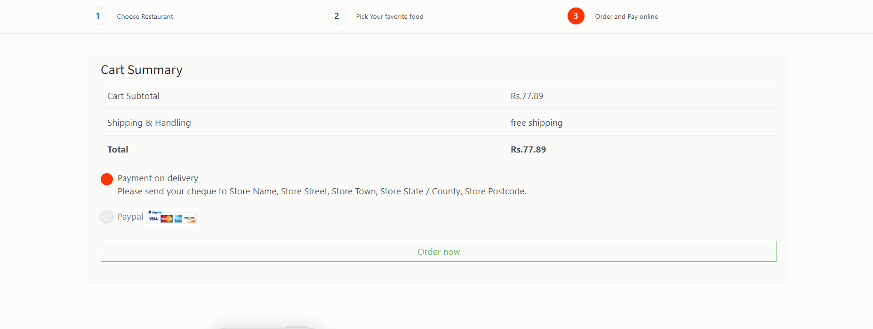
ORDER SUMMARY

Slide 16
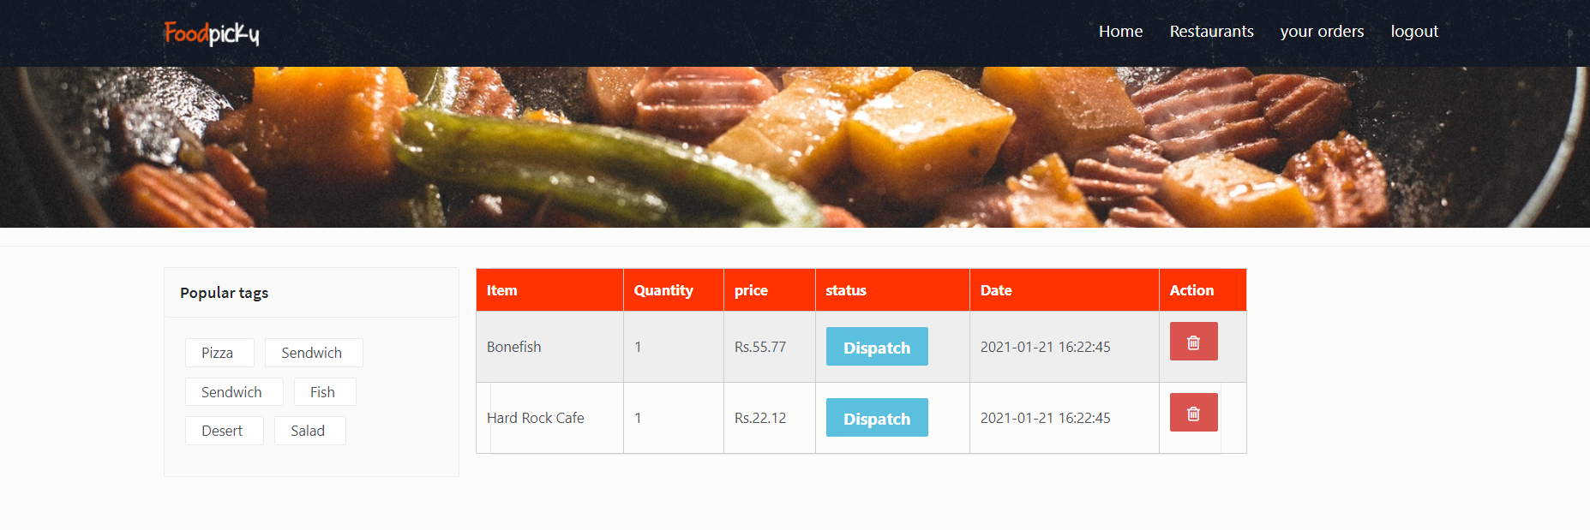
YOUR ORDERS

Slide 17
THANK YOU

